Slide 1
OBBBA for United Way Chapters:
What You Need to Know
October 10, 2025

Slide 3
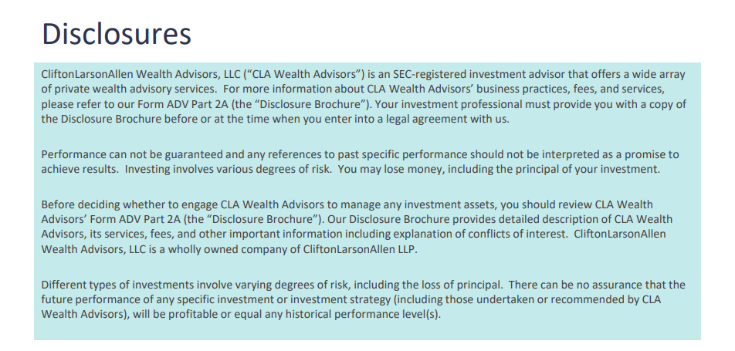

Slide 4
Overview and Backdrop
One Big Beautiful Bill Act (OBBBA or OB3A) passed
July 4, 2025
This agenda covers the most impactful changes for nonprofit organizations within the final bill
Prior versions of the bill included potentially harmful provisions to nonprofits that were REMOVED including:
Fringe benefit taxation (dreaded parking tax!)
Research income limitations
Expedited status revocation
Foundation excise tax increases

Slide 5
Charitable Deductions
Individual Donor Changes

Slide 6
Donors who take the Standard Deduction
90% of US households fall into this category
New $1,000 “above the line” charitable deduction (2026)
$2,000 for married filing joint (MFJ) tax returns
Must be cash contributions to qualified charities (not DAFs)
No phase outs
Potential Tax Savings Example:
MFJ couple with $150,000 household income - $440 tax savings
22% of gift funded with tax dollars
No changes to qualified charitable distributions

Slide 7
Donors who Itemize
Overall changes to itemized deductions
Increase to SALT deduction (2025 – 2028)
Charitable deduction changes
Introduction of 0.5% AGI “floor” for charitable deductions (2026)
Effective rate cap: 37% bracket taxpayers limited to 35% charitable deduction
Donor tax impact scenarios
Bunching – via multi-year gift or via a DAF

Slide 8
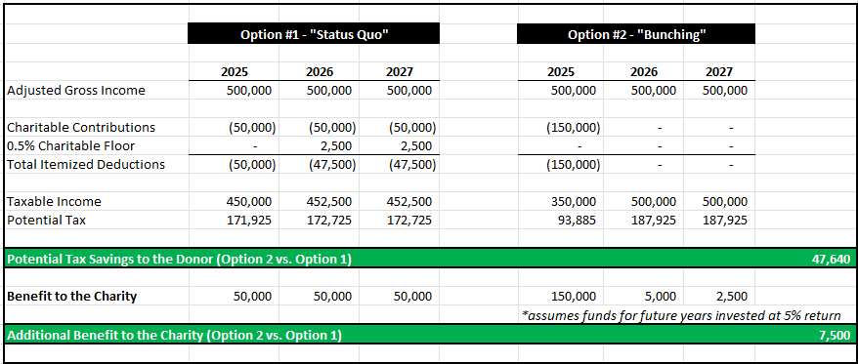
Example - Possible Taxpayer Outcome

Slide 9
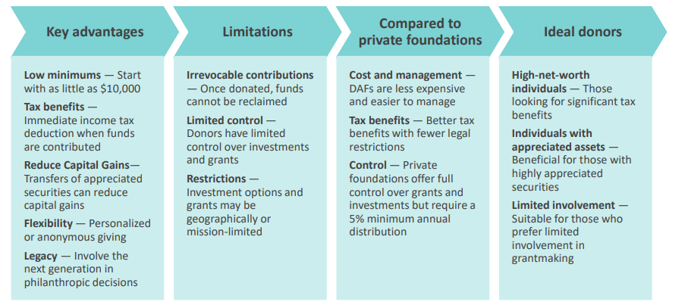
DAF Basics for Donors

Slide 10
Impacts of DAFs for Clubs
Potential challenges:
  Relationship with donor now includes a 3rd party – the DAF sponsor.
  Donor advises the distributions – but doesn't technically control them (though rare for a DAF to not follow donor's intent)
  DAF sponsors vary- some push donors to distribute funds more quickly; others do not (and may not be incentivized to do so as they are paid based on assets under management)
Potential opportunities:
  Targeted work with engaged DAF sponsors to encourage more DAFs to contribute to your Club
  Donors to DAFs will receive tax savings- opportunity to approach about investing those savings in your Club

Slide 11
Club Accounting Reminders re: DAF contributions
DAF cannot make – or fulfill- a pledge
Donors who “make a pledge” indicating they will pay via their DAF cannot be counted as a pledge per GAAP – considered an intent to give, but revenue should not be recorded until payment is received
Best practice once DAF contribution received is to track soft credit (associated donor) and hard credit (DAF) in CRM for a gift from a DAF; the DAF sponsor is noted as the donor for 990 Schedule B

Slide 12
Corporate Contribution – Deduction Changes
New 1% Floor on Charitable Contribution Deductions
EXAMPLE:
  A corporation with a taxable income of $1 million.
  The 1% floor would be $10,000, meaning the corporation can only deduct charitable contributions that exceed $10,000
  The total deductible amount remains capped at 10% of taxable income, which would be $100,000.
  Any contributions below the threshold are not deductible and can be carried forward for up to 5 years.
There is a risk that some companies (motivated by tax benefits) may scale back routine donations. In outreach to corporate partners, acknowledge the new limit and propose larger, planned gifts (or multi-year pledges) that meet the 1% threshold for deductibility.
Notes:
Want to touch on the corporate side of items since many organizations receive corporate donations. Many of your organizations accept corporate donations, so want to give you a high level overview of changes that are coming.
Beginning January 1, 2026, a corporate taxpayer may claim a charitable deduction only if the charitable contribution exceeds 1% of the taxpayer’s taxable income and does not exceed 10% of their taxable income.
Please connect with your corporate partners – they may have different giving strategies in mind - (motivated by tax benefits) – they may scale back routine donations if they’re not typically giving at the 10% limitation.
Reach out to your corporate donors and have a discussion – you can acknowledge the new limitations and propose larger, planned gifts (or multi-year pledges) that meet the 1% threshold for deductibility.
NATALIE

Slide 13
Charitable Giving & Sponsorship Considerations
Corporate sponsorship arrangements are still a viable business alternative that provides a charity with funding and provides positive business exposure (e.g., corporate branding for the corporate sponsor.)
It is important to note there were no changes to sponsorship payment deductibility
Payments should be considered in contribution planning — as they could be deductible as business expenses under IRC Section 162.
Understand possible UBTI / advertising considerations
Notes:
What You Can Do Now
Review your current giving strategies in light of this new threshold
Collaborate with your finance and tax teams to ensure proper classification of donations
Reclassify where appropriate: Consider sponsorships instead of the normal charitable contributions
Stay informed: As the business and philanthropic community navigate the new realities of this legislation we anticipate more to be written on this topic.
Recommend contacting your tax advisor – which thankfully
Im going to Pass it over to Kelsey for some other OB3A changes

Slide 14
Other Relevant OBBBA Changes

Slide 15
New Overtime Tax Deduction
Beginning with the 2025 tax year and continuing through 2028, the One Big Beautiful Bill Act (OBBBA) introduces a new federal income tax deduction specifically for qualifying overtime pay. This provision allows eligible employees to deduct up to $12,500 from their federal taxable income, or $25,000 for those filing jointly, based on the premium portion of their overtime earnings.
What counts as “premium” overtime pay?
Under the Fair Labor Standards Act (FLSA), overtime pay is typically calculated as “time-and-a-half.” The premium portion refers to the extra “half” paid above the employee’s regular hourly rate. Only overtime mandated by the FLSA qualifies for this deduction and overtime earned under state specific laws does not.
For example, if an employee’s regular rate is $15 per hour, the employee’s overtime rate (time and one-half) is $22.50 per hour.
Only the $7.50 overtime premium for that hour may be deducted.
Notes:
The new overtime tax deduction is a new federal income tax deduction to employees beginning 2025 and continuing through 2028, for qualifying overtime pay. The deduction begins to phase-out when the taxpayer’s modified adjusted gross income exceeds $150,000 ($300,000 in the case of a joint return.)
This provision allows eligible employees to deduct up to $12,500 from their federal taxable income, or $25,000 for those filing jointly, based on the premium portion of their overtime earnings.
Under the Fair Labor Standards Act (FLSA), overtime pay is typically calculated as “time-and-a-half.” The premium portion refers to the extra “half” paid above the employee’s regular hourly rate. Only overtime mandated by the FLSA qualifies for this deduction and overtime earned under state-specific laws does not.

Slide 16
Overtime Tax Deduction and 1099 Update
Employees receive their overtime pay as usual through their paycheck. The tax benefit comes later, when filing their annual tax return, by deducting the premium portion of qualified overtime from their taxable income using the data reported on their W-2.
The deduction is applied when employees file their Form 1040, potentially lowering their overall federal tax liability or increasing their refund.
Form 1099 threshold for non-employees:
Starting in 2026, the threshold rises from $600 to $2,000, adjusted annually for inflation. 1099s filed in Jan 2026 for 2025 follow current rules.

Slide 17
Green Energy Credits – Legislative Changes
Credit | One Big Beautiful Bill
Section 45W – Commercial Clean Vehicles | Repeals credit for vehicles acquired after September 30, 2025.
Section 30C – Alternative Fuel Refueling Credit | Repeals credit for property placed in service after June 30, 2026.
Section 48E – Clean Electricity Investment Credit | Accelerates the expiration of the tax credit for wind and solar facilities. For property whose construction began 12 months or more after the date of enactment, the earlier phase out of tax credit applies to property placed in service after December 31, 2027. For property whose construction begins within 12 months of date of enactment, the original phase out rules apply.
Section 179D – Energy Efficient Commercial Building Deduction | Terminates the deduction for property that begins construction more than 12 months after DOE.

Slide 18
Green Energy Credits – Know Your Dates!
Effective for assets placed in service on or after 1/1/2023
Credits may be claimed once property is placed in service
Fiscal year end will determine period in which property is placed in service and tax return due dates
Construction start date is important under the Inflation Reduction Act
Construction generally starts when:
5% or more of the cost of the property is paid or incurred, or
Physical work of a significant nature begins
Executive order issued July 2025 may change the governing rules for Sections 45Y and 48E

Slide 19
Medicaid and SNAP Changes
OBBBA included significant Medicaid changes including:
Eligibility requirements for individuals to qualify
Cuts to Medicaid funding- will run through states; direct impacts to be seen in 2026-2027 and will vary by state, program, etc.
Supplemental Nutrition Assistance Program (SNAP)
Changes in eligibility requirements
Shifting more to states
Impact to Clubs: Youth and families served; assistance needed. State funding ripple-effects

Slide 20
Thank you!
Robbie Williams, Principal
robert.williams@CLAconnect.com
Rob Cappellucci, Principal
robert.cappellucci@claconnect.com

